Slide 1


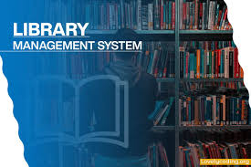
CSA0964– Programming in Java - Professional Level
Library management system
Guided By, Project By,
T. Vincent Gnanaraj M.Monish
(Course Faculty) (192210315)
Programming in Java Computer Science Engineering
SSE, SIMATS SSE, SIMATS

Slide 2
ABSTRACT
The Library Management System (LMS) is a comprehensive software designed to automate library functions, enhancing efficiency for both librarians and patrons. It includes features for cataloging, member management, circulation, and reporting, enabling streamlined data entry, member profile handling, and automated tracking of check-ins and check-outs. The system provides real-time inventory updates, advanced search options, and detailed usage reports to inform library decisions. With a user-friendly interface and mobile compatibility, the LMS ensures easy access and interaction, while robust security measures protect user data and transaction integrity. This system not only improves operational efficiency but also elevates user satisfaction by offering a seamless library experience.
Keywords : Library Management System, Data Base,security Features

Slide 3

Introduction
A library management system (LMS) is a software application designed to manage and automate various functions of a library. It serves as an integrated system to streamline the library’s operations, providing numerous benefits and functionalities to both the library staff and its patrons.
Libraries play a crucial role in providing access to information and resources to a diverse set of users. However, managing a library's operations, which include cataloging, circulation, user management, inventory control, and reporting, can be challenging and time-consuming when done manually.
The LMS supports efficient data entry, member management, real-time inventory updates, and advanced search options, making library resources easily accessible and manageable.
The LMS offers an intuitive interface, mobile compatibility, and advanced security measures, ensuring a seamless and secure experience for both librarians and patrons.

Slide 4
Hardware & Software Requirement
HARDWARE:
PROCESSOR: AMD Ryzen 5 4600H with Radeon Graphics
MEMORY: 8GB RAM
STORAGE: 512GB SSD
GRAPHIC CARD: IN-BUILT
RADEON GRAPHICS.
SOFTWARE:
OS: WINDOWS 10/11
JAVA: java JDK 21
INTEGRATED DEVELOPMENT ENVIRONMENT (IDE) :Visual Studio Code
Java Edition: J2SE

Slide 5
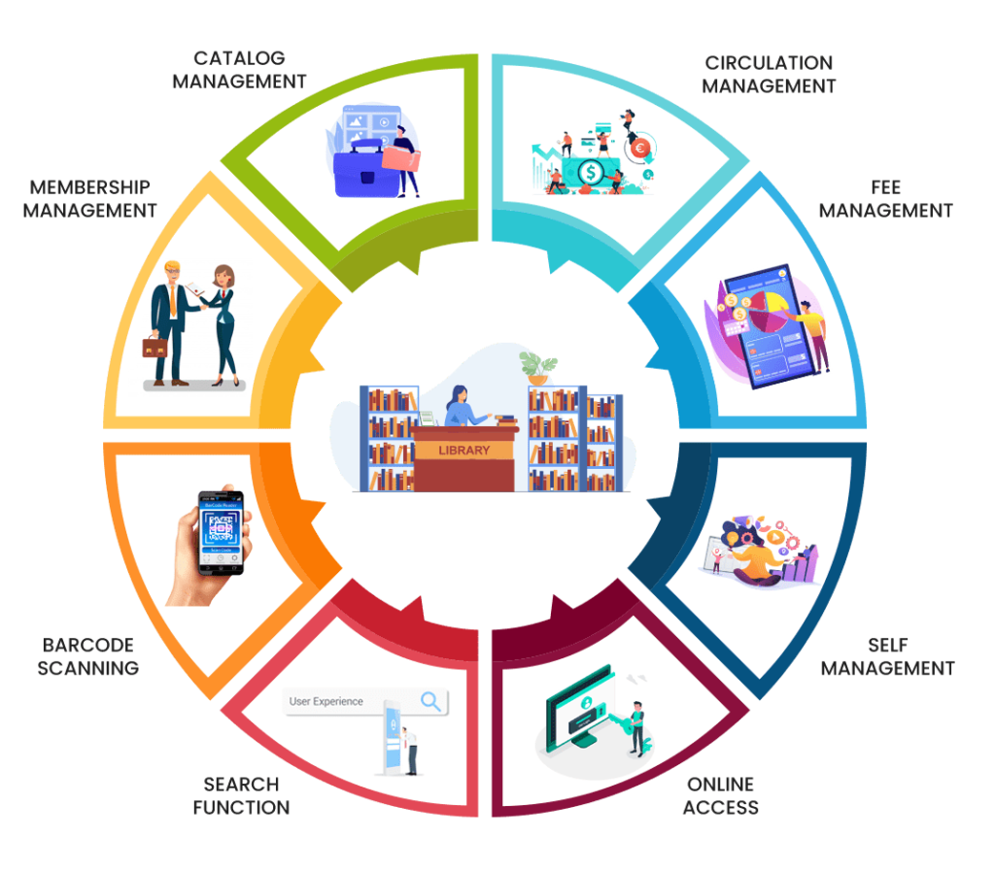
Existing System
Lack of robust data management and reporting tools hampers insights into usage patterns and decision-making.
Most traditional libraries operate using manual processes to manage their operations.
These processes involve physical records, paper-based catalogs, and direct human intervention for virtually every task.
Outdated systems may have insufficient security measures, risking data breaches and unauthorized access.

Slide 6
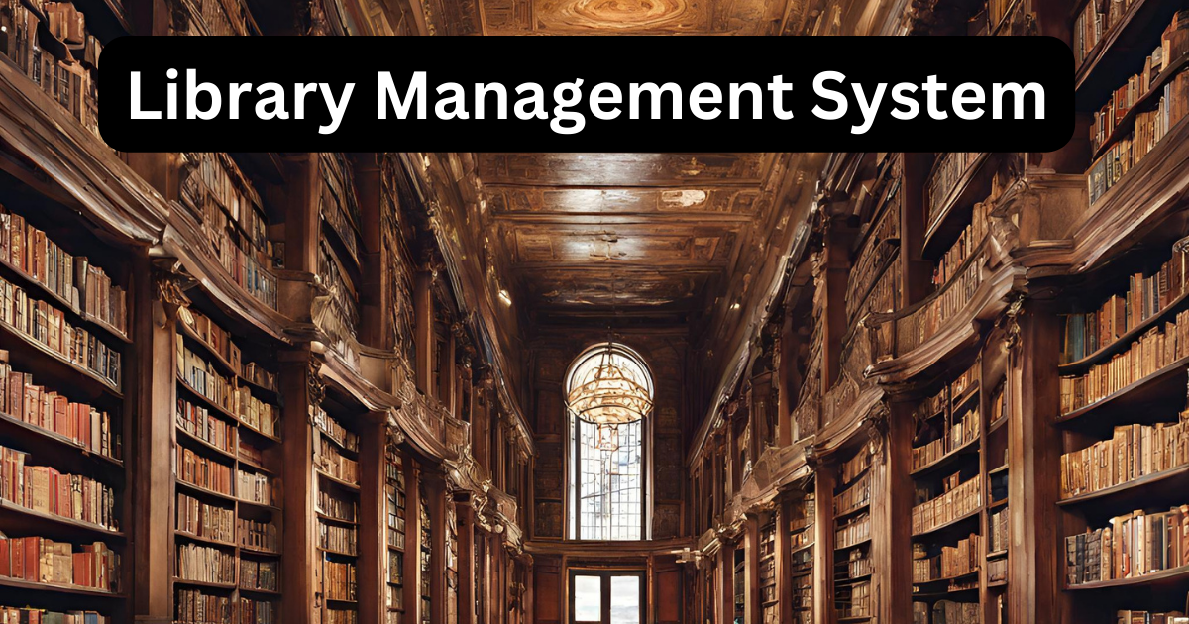
Proposed System
A central hub displaying key library statistics and notifications, providing librarians with a quick overview of library performance.
An intuitive interface for adding new books to the system, allowing librarians to input book details and upload cover images efficiently.
A section for managing member profiles, enabling librarians to create, edit, and delete member accounts, as well as view borrowing history.
A user-friendly interface for patrons to search for books, check availability, reserve items, and manage borrowing transactions. Librarians can efficiently handle check-ins, check-outs, and renewals from this interface.

Slide 7
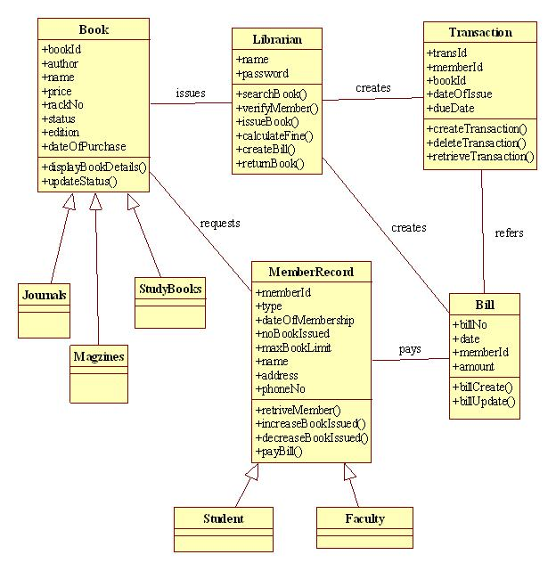
Architecture

Slide 8
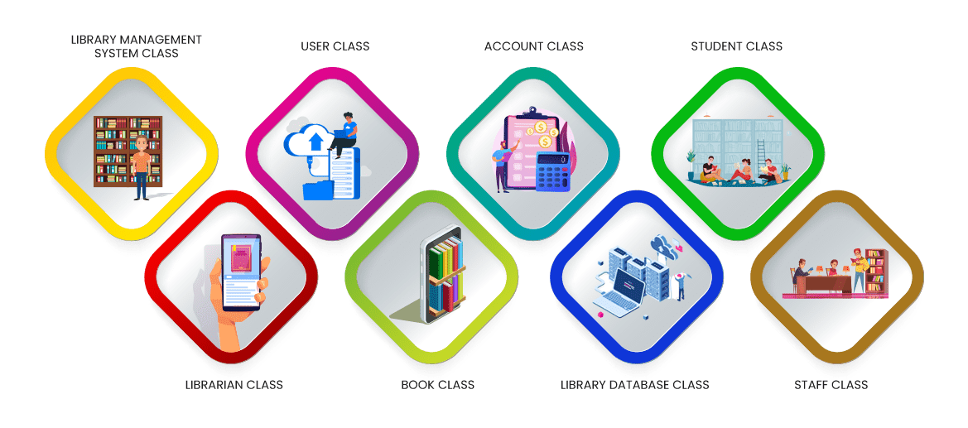
DESIGN

Slide 9
Coding
public class AdminLogin extends JFrame {
static AdminLogin frame;
private JPanel contentPane;
private JTextField textField;
private JPasswordField passwordField;
public static void main(String[] args) {
EventQueue.invokeLater(new Runnable() {
public void run() {
try {
frame = new AdminLogin();
frame.setVisible(true);
} catch (Exception e) {
e.printStackTrace();
public AdminLogin() {
setDefaultCloseOperation(JFrame.EXIT_ON_CLOSE);
setBounds(100, 100, 450, 300);
contentPane = new JPanel();
contentPane.setBorder(new EmptyBorder(5, 5, 5, 5));
setContentPane(contentPane);
JLabel lblAdminLoginForm = new JLabel("Admin Login Form");
lblAdminLoginForm.setForeground(Color.GRAY);
lblAdminLoginForm.setFont(new Font("Tahoma", Font.PLAIN, 18));
import java.awt.BorderLayout;
import java.awt.EventQueue;
import javax.swing.JFrame;
import javax.swing.JPanel;
import javax.swing.border.EmptyBorder;
import javax.swing.GroupLayout;
import javax.swing.GroupLayout.Alignment;
import javax.swing.JLabel;
import javax.swing.JOptionPane;
import java.awt.Font;
import java.awt.Color;
import javax.swing.JTextField;
import javax.swing.JButton;
import java.awt.event.ActionListener;
import java.awt.event.ActionEvent;
import javax.swing.JPasswordField;

Slide 10
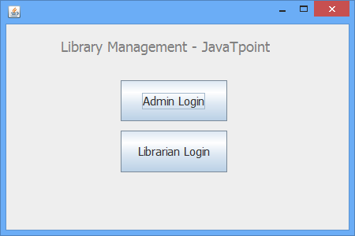
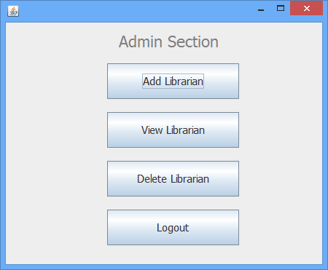
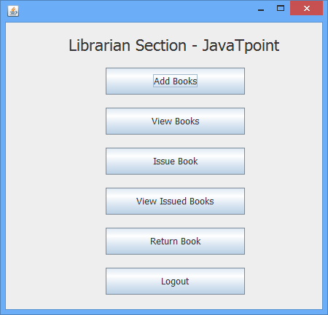
Final Output

Slide 11
Testing
Functionality Testing:
Verify that all core functions such as cataloging, member management, circulation, and reporting work correctly.Ensure that users can perform essential tasks like adding books, registering members, borrowing and returning items without errors.
2. Security Testing:
Test user authentication mechanisms to ensure that only authorized users can access the system. Verify encryption of sensitive data like user passwords and transaction details to prevent unauthorized access.
3. Usability Testing:
Evaluate the system's user interface for ease of use, intuitiveness, and efficiency.
Ensure that navigation is straightforward and that users can easily find and use the system's features.

Slide 12

Implementation
Plan the system architecture and user interface layout, considering requirements and stakeholders' inputs.
Implement core functionalities using technologies like JavaFX for the user interface and MySQL for the database.
Conduct thorough testing, including functionality, security, usability, and compatibility testing, to ensure reliability and security.
Deploy the system, migrate data if needed, conduct user training, and provide ongoing maintenance and support for stability and enhancements.

Slide 13
Future Scope
Explore integrating emerging technologies such as artificial intelligence (AI) for personalized recommendations, or blockchain for enhanced security and transparency in transactions.
Focus on improving the user interface and experience by incorporating modern design principles, responsive layouts, and accessibility features to cater to a diverse user base.
Consider developing a mobile version of your LMS using Java frameworks like JavaFX for Android or using cross-platform tools like Flutter or React Native to reach a wider audience and provide convenience for users on-the-go.
Continuously add new features and functionalities to your LMS based on user feedback and evolving requirements, such as support for digital resources, multimedia content, social collaboration, or advanced search capabilities.

Slide 14
CONCLUSION
In conclusion, in JavaFX-based Library Management System (LMS) offers a reliable solution for efficient resource management. Through rigorous testing and maintenance, including bug fixes and updates, the system ensures stability and scalability.
Future opportunities for integration with emerging technologies, mobile development, and cloud adoption promise further enhancements.
By prioritizing user experience and continually expanding features, the LMS remains relevant and adaptable to evolving needs.
Overall, the JavaFX LMS stands as a robust tool for organizing and accessing knowledge resources, poised for continued growth and innovation in library technology.

Slide 15
REFERENCE
[1] S. Fu, Y. Z., Seinminn, “Library Management System Based on Recommendation System,” International Conference on Information Computing and Applications, Springer, Berlin, Heidelberg, pp 488-497, 2013.
[2] J. M. Hellerstein, M. Stonebraker, J. Hamilton, “Architecture of a Database System,” Journal Foundations and Trends in Databases, USA, Vol 1, Issue 2, pp 141-259, 2007.
[3] Y. Nie, “Digital Library Billing Management System Design and Implementation,” Advanced Research on Electronic Commerce, Web Application, and Communication. Communications in Computer and Information Science, vol 143. Springer, Berlin, Heidelberg, pp 352-358, 2011
[4] R. Salman, “Developing Multithreaded Database Application Using Java Tools and Oracle Database Management System in Intranet Environment,” International Conference on Advanced Information Technologies and Applications, pp. 67–79, 2015.

Slide 16


